Slide 1

Soil Analyzer Analyse the soil fertility with the essential nutrients present in the soil
SRM INSTITUTE OF SCIENCE AND TECHNOLOGY
SCHOOL OF COMPUTING
DEPARTMENT OF COMPUTING TECHNOLOGIES
18CSP107L - MINOR PROJECT
Guide name: Dr. P. Rama
Designation: Assistant Professor Department: Computing Technologies
Batch ID: 470
Student 1 Reg. No: RA2011003010044
Student 1 Name: Prakash Y
Student 2 Reg. No: RA2011003010125
Student 2 Name: Jagadeesh S

Slide 2
Abstract
In this presentation, we delve into the realm of data-driven agriculture by introducing a novel approach to soil analysis using machine learning. Our project aims to predict soil fertility through the integration of essential nutrients and key soil properties. By harnessing historical soil data alongside factors such as pH, electrical conductivity, organic content, and micro/macronutrient levels, our machine learning model offers a predictive framework for assessing soil health. Through a systematic approach encompassing data collection, preprocessing, feature engineering, model selection, and validation, we empower farmers and land managers with accurate fertility predictions. This presentation sheds light on the potential of modern technology to revolutionize agriculture practices, enabling sustainable cultivation and informed decision-making.

Slide 3
Introduction
As we know, India is the second largest population country in the world and the majority of people in India have agriculture as their occupation. Farmers are growing the same crops repeatedly without trying a new variety of crops and they are applying fertilizers in random quantities without knowing the deﬁcient content and quantity. So, this is directly aﬀecting crop yield and also causes soil acidiﬁcation and damages the top layer. So, we have designed the system using machine learning algorithms for the betterment of farmers.
Agriculture is one of the important occupations practiced in India. It is the broadest economic sector and plays the most important role in the overall development of the country. In the Agriculture ﬁeld machine learning, for instance, is not a mysterious trick or magic, it is a set of well-deﬁned models that collect speciﬁc. This all input data applies to machine learning predictive algorithms to identify the pattern among data and then process it as per input conditions. data and apply speciﬁc algorithms to achieve expected results.

Slide 4
Literature review
Jamshed, Muhammad Ammar. “Analyze Soil Fertility Using Deep Learning Convolutional Neural Networks.” Shanlax International Journal of Arts, Science and Humanities, vol. 10, no. 3, 2023, pp. 1–5.
Abstract: This research revolves around how plant soil potential can be further discovered and used for farming through detection of relevant nutrients and chemicals within the soil landscapes within areas and even desert climates and how we can improve land soil fertility of the purpose of farming both using Convolutional neural networks which process of imagery in layers and predictive detections of objects within image backgrounds and frontal lobes.
Introduction: The majority of research and application done towards layered imaging in trying to separate layers of structures to discover minerals and fertility rates have mostly been applied using supervised machine learning algorithms in combination with Computer vision methodologies such as CNN and OpenCV.
CNN analytics with soil fertility data might be the first phase of trying to discover the schematics of components fertility of soil to further assess using principal component analysis and apply clustering algorithms to visualize how minerals and land structures may be possessing a statistically significant relationship leading towards a predictable CNN model of Soil fertility in new farmlands.

Slide 5
Existing System
Laboratory Testing: Traditional soil testing involves collecting soil samples and sending them to a laboratory for analysis. Soil samples are analyzed for essential nutrients (N, K, P, Ca, S), pH, organic carbon (OC), and electrical conductivity (EC). Laboratory tests provide accurate and detailed results but are often time-consuming and require specialized equipment and expertise.
Soil Testing Kits: Various commercially available soil testing kits provide a simplified way to analyze basic soil properties. These kits typically include colorimetric tests for pH and sometimes N, P, and K. While these kits are portable and relatively quick, they may lack the precision and comprehensive analysis provided by laboratory methods.
Field Observations: Experienced agronomists and farmers often rely on visual cues and field observations to assess soil health and nutrient deficiencies. This might involve looking for signs of nutrient deficiency in plants or considering factors like plant growth, color, and yield. While this approach is practical, it is subjective and may not provide precise quantitative data.

Slide 6
Comparison of Existing Methods with Merits and Demerits
Merits:
Accuracy: Laboratory testing provides accurate measurements of soil properties and nutrient levels.
Standardized Procedures: Established procedures and protocols for soil testing ensure consistency.
Expert Interpretation: Analysis results are often interpreted by trained professionals, offering valuable insights.
Proven Approach: Traditional methods have been used successfully for years in agricultural practices.
Demerits:
Time-Consuming: Laboratory testing and analysis are time-intensive processes, delaying decision-making.
Labor-Intensive: Collecting samples and sending them to labs requires effort and resources.
Limited Spatial Data: Traditional methods might not provide detailed spatial variations in soil properties.
Costly: Lab testing, equipment, and expert interpretation can be expensive.
Subjective Interpretation: Interpretation can vary based on the expertise of the analyst.

Slide 7
Challenges to address
Traditional soil analysis methods address challenges including:
Accuracy and Reliability:
Rigorous laboratory processes and quality control ensure accurate results.
Standardized Protocols:
Established protocols maintain consistent testing procedures.
Expert Interpretation:
Trained experts provide insights and recommendations.
Historical Data:
Soil surveys and historical data inform soil properties.
Local Expertise:
Local agronomists offer region-specific advice.
Sampling Techniques:
Standardized methods ensure representative samples.
Laboratory Infrastructure:
Equipped labs handle comprehensive analysis.
Time-Consuming Analysis:
Though slow, accurate results guide decisions.
High Cost:
Accuracy justifies expenses for improved yields.
Limited Accessibility:
Mobile testing units bridge remote access gaps.

Slide 8
Problem Statement and Objectives
Traditional methods of soil fertility analysis are often time-consuming, labor-intensive, and may lack precision. Farmers and agricultural experts require a more efficient and accurate solution to predict essential nutrient levels (N, K, P, Ca, S), pH, organic carbon (OC), and electrical conductivity (EC) in soil. The absence of an automated system for soil fertility assessment hinders optimal crop growth and yield.
Objective:
The purpose of deploying this project is to revolutionize soil analysis and nutrient management in agriculture. By leveraging advanced technologies like machine learning and data analytics, the project aims to provide accurate and real-time predictions of soil fertility.
This predictive capability will empower farmers to make informed decisions about nutrient application, leading to optimized crop yields, resource efficiency, and sustainable farming practices. Ultimately, the deployment of this project aims to enhance agricultural productivity, reduce environmental impact, and contribute to global food security.

Slide 9
Proposed System
Collect a diverse dataset of soil samples encompassing essential nutrients (N, K, P, Ca, S), pH, organic carbon (OC), and electrical conductivity (EC).
Preprocess the data to handle missing values, outliers, and normalize features for consistent model performance.
Select and implement suitable machine learning algorithms for soil fertility prediction, such as Random Forest or Gradient Boosting.
Train the models using the preprocessed dataset, employing cross-validation and hyperparameter tuning techniques to optimize performance.
Develop a user-friendly web-based interface that allows users to input soil data easily.
Design an intuitive UI with clear instructions, input fields, and interactive elements for an enhanced user experience.
Implement the trained machine learning models in the backend of the system to generate predictions based on user-inputted soil data.
Process the input data through the models to produce predictions for essential nutrient levels, pH, OC, and EC.

Slide 10
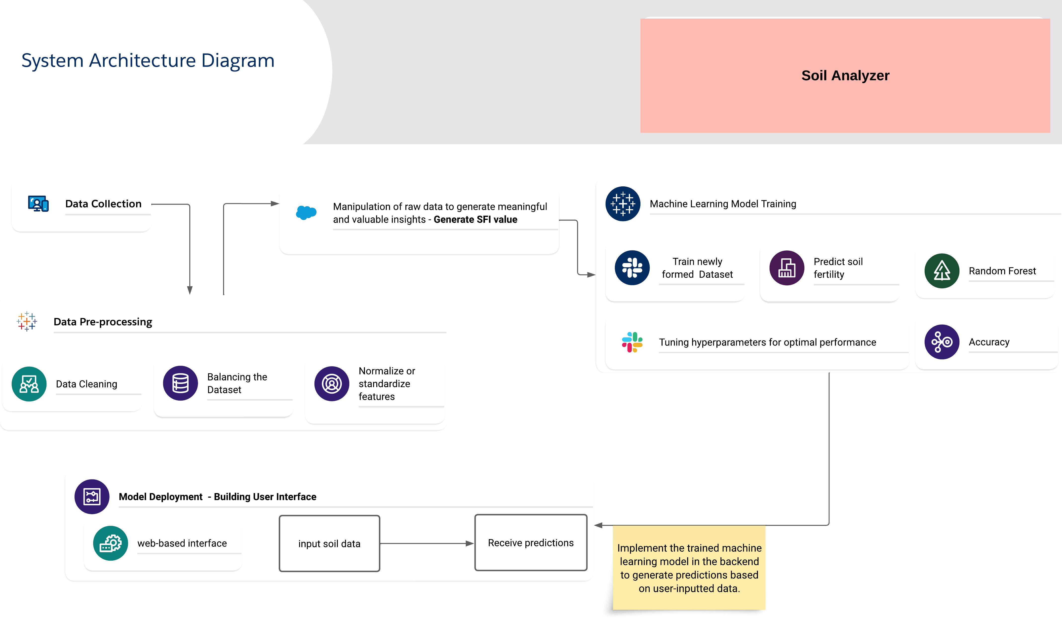
Architecture Diagram of the proposed model

Slide 11
Modules Description
1. Data Collection and Storage:
Gather diverse soil samples with essential nutrients, pH, OC, EC, and other properties.
Store the collected data in a structured database.
2. Data Preprocessing:
Clean the data by handling missing values, outliers, and errors.
Normalize or standardize features to ensure consistent scaling.
3. Generating SFI value:
With the necessary information such as Nutrient Score, pH Score, EC Score, OC Score and Texture Score we can calculate the Soil fertility index score.
4. Machine Learning Model Training:
Choose appropriate machine learning algorithms (Random Forest) for the prediction task.
Split the data into training and validation sets.
Train the chosen models using the training data, tuning hyperparameters for optimal performance.
4. Model Deployment:
Design a web-based interface where users can input soil data and receive predictions.
Create user-friendly input forms with appropriate validations.
Implement the trained machine learning model in the backend to generate predictions based on user-inputted data.

Slide 12
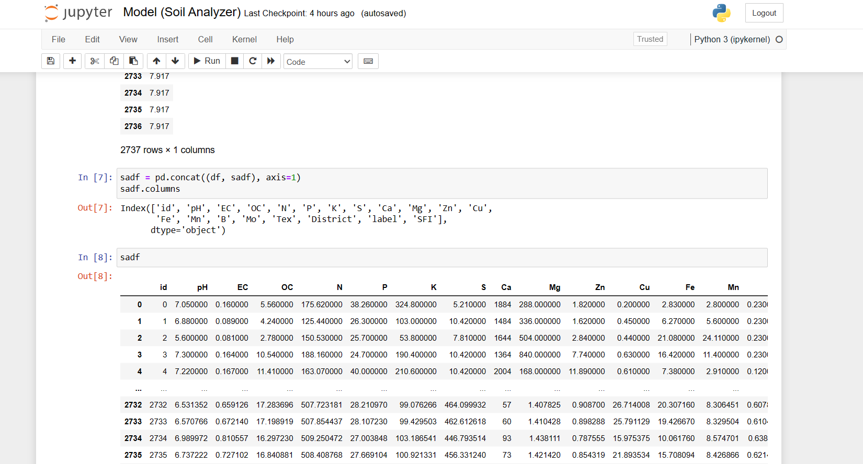
Intermediate Results and Discussion

Slide 13
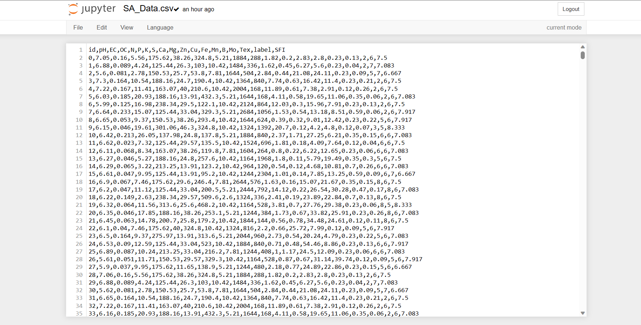
Newly formed Dataset:

Slide 14
In the provided dataset, which encompasses parameters such as pH, electrical conductivity (EC), organic carbon (OC), and various micronutrient levels, an additional layer of insight has been introduced through the calculation of a soil fertility index.
This index is a synthesized metric that encapsulates the holistic fertility of the soil, merging the individual parameters into a single value. By employing specific formulas and calculations, this index offers a comprehensive evaluation of the soil's fertility status, integrating key factors that influence plant growth and productivity.
The inclusion of the soil fertility index in the dataset enhances its utility by providing a consolidated measure that simplifies decision-making processes related to agricultural practices and resource allocation.
This index becomes an invaluable tool for understanding the overall soil health and determining appropriate strategies for optimizing crop cultivation and land management practices.

Slide 15
References
Kaggle Dataset prepared by G. B. Pant University of Agriculture and Technology.
Analyze Soil Fertility Using Deep Learning Convolutional Neural Networks: Analyze Soil Fertility using Deep Learning Convolutional Neural Networks (researchgate.net)
Soil Classification Using Machine Learning, Deep Learning, and Computer Vision: Soil Classification Using Machine Learning, Deep Learning, and Computer Vision: A Review | SpringerLink
Pant J, Pant P, Pant RP, Bhatt A, Pant D, Juyal A (2021) Soil quality prediction for determining soil fertility in Bhimtal Block of Uttarakhand (India) using machine learning. Int J Anal Appl 19(1):91–109 Soil Quality Prediction for Determining Soil Fertility in Bhimtal Block of Uttarakhand (India) Using Machine Learning | International Journal of Analysis and Applications (etamaths.com)
SK AL Zaminur Rahman, Kaushik Chandra Mitra and S.M Mohidul Islam, “Soil Classification using Machine Learning Methods and Crop Suggestion Based on Soil Series”, 2018 IEEE, 21st International Conference of Computer and Information Technology (ICCIT), pp.978-1-5386-9242-4/ 18
Pramudyana Agus Harlianto, Teguh Bharata Adji and Noor Akhmad Setiawan, “Comparison of Machine Learning Algorithm for Soil Type Classification”, 2017 3rd International Conference on Science and TechnologyComputer(ICST).

Slide 16
UML Diagrams for the proposed modules (Appropriate UML diagrams to be included)
30% of implementation with demo
Innovation idea of the project
Scope and application of the project

